Slide 1

Why we need Version Control system?
Concept without version control System

Slide 2
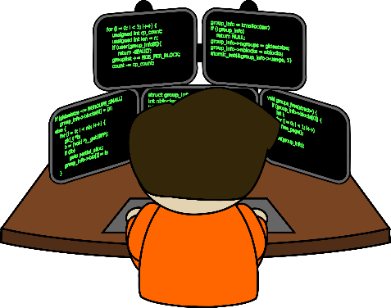

Coder 1st
Distribute 3 Tasks
Task 1
Task 2
Task 3

Slide 3
Leader
Main Task
Coder 2
Coder 3
Coder 4
Distribute 3 Tasks
Task 1
Task 2
Task 3

Slide 4
Leader
After completion of Task 1
Main Task
Coder 2
Coder 3
Coder 4
Task 2 Depended on Task 1
Task 1
Task 2
Task 3

Slide 5
Leader
After completion of Task 1
Main Task
Coder 2
Coder 3
Coder 4
Coder 2 submit code to Leader
Task 1
Task 2
Task 3

Slide 6
Leader Give changes to Coder 2
Leader
Main Task
And Code to Coder3 and coder 4
Changes
Coder 2
Coder 3
Coder 4
occur
Coder 2 submit code to Leader
Task 2
Task 3

Slide 7
Leader
Main Task
Coder 2
Coder 3
Coder 4
Changes
Task 2
Task 3

Slide 8
Leader
Main Task
Coder 2
Coder 3
Coder 4
Conflict occur due to change
Changes
Task 2
Task 3

